Slide 1
Leadership
Chapter
17
© 2007 Prentice Hall, Inc.
All rights reserved.

Slide 2
Leaders and Leadership
Leader – Someone who can influence others and who has managerial authority
Leadership – What leaders do; the process of influencing a group to achieve goals
Ideally, all managers should be leaders
© 2007 Prentice Hall, Inc. All rights reserved.
17–<number>

Slide 3
Providing Ethical Leadership
Ethics are part of leadership when leaders attempt to:
  Foster moral virtue through changes in attitudes and behaviors.
  Use their charisma in socially constructive ways.
  Promote ethical behavior by exhibiting their personal traits of honesty and integrity.
Moral Leadership
  Involves addressing the means that a leader uses to achieve goals as well as the moral content of those goals.
© 2007 Prentice Hall, Inc. All rights reserved.
17–<number>

Slide 4
Empowering Employees
Empowerment
  Involves increasing the decision-making discretion of workers such that teams can make key operating decisions in develop budgets, scheduling workloads, controlling inventories, and solving quality problems.
  Why empower employees?
    Quicker responses problems and faster decisions.
    Addresses the problem of increased spans of control in relieving managers to work on other problems.
© 2007 Prentice Hall, Inc. All rights reserved.
17–<number>

Slide 5
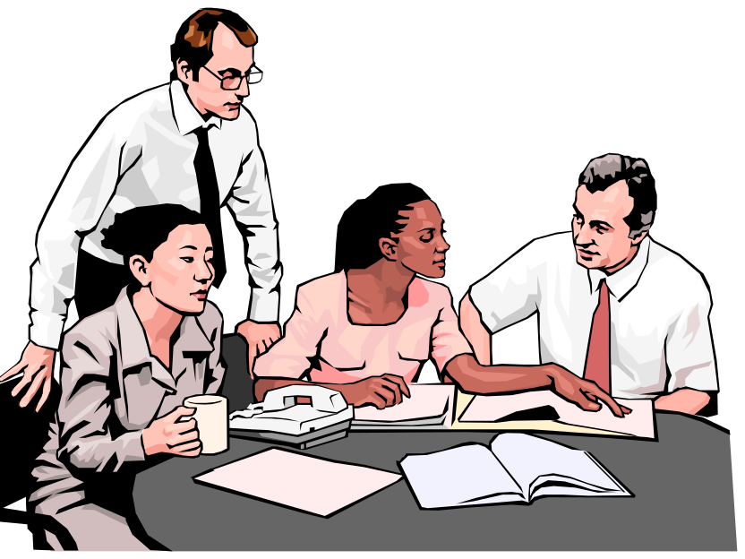
Cross-Cultural Leadership
Universal Elements of Effective Leadership
  Vision
  Foresight
  Providing encouragement
  Trustworthiness
  Dynamism
  Positiveness
  Proactiveness
© 2007 Prentice Hall, Inc. All rights reserved.
17–<number>

Slide 6
Exhibit 17–10 Selected Cross-Cultural Leadership Findings
Korean leaders are expected to be paternalistic toward employees.
Arab leaders who show kindness or generosity without being asked to do so are seen by other Arabs as weak.
Japanese leaders are expected to be humble and speak frequently.
Scandinavian and Dutch leaders who single out individuals with public praise are likely to embarrass, not energize, those individuals.
Effective leaders in Malaysia are expected to show compassion while using more of an autocratic than a participative style.
Effective German leaders are characterized by high performance orientation, low compassion, low self-protection, low team orientation, high autonomy, and high participation.
Source: Based on J. C. Kennedy, “Leadership in Malaysia: Traditional Values, International Outlook,” Academy of Management Executive, August 2002, pp. 15–17; F.C. Brodbeck, M. Frese, and M. Javidan, “Leadership Made in Germany: Low on Compassion, High on Performance,” Academy of Management Executive, February 2002, pp. 16–29; M. F. Peterson and J. G. Hunt, “International Perspectives on International Leadership,” Leadership Quarterly, Fall 1997, pp. 203–31; R. J. House and R. N. Aditya, “The Social Scientific Study of Leadership: Quo Vadis?” Journal of Management, vol. 23, no. 3, (1997), p. 463; and R. J. House, “Leadership in the Twenty-First Century,” in A. Howard (ed.), The Changing Nature of Work (San Francisco: Jossey-Bass, 1995), p. 442.
© 2007 Prentice Hall, Inc. All rights reserved.
17–<number>

Slide 7
Gender Differences and Leadership
Research Findings
  Males and females use different styles:
    Women tend to adopt a more democratic or participative style unless in a male-dominated job.
    Women tend to use transformational leadership.
    Men tend to use transactional leadership.
© 2007 Prentice Hall, Inc. All rights reserved.
17–<number>

Slide 8
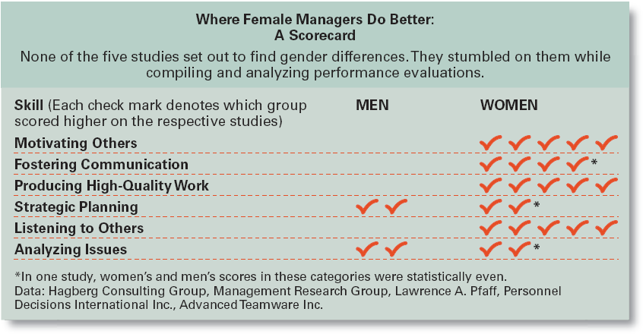
Exhibit 17–11 Where Female Managers Do Better: A Scorecard
Source: R. Sharpe, “As Leaders, Women Rule,” BusinessWeek, November 20. 2000, p. 75.
© 2007 Prentice Hall, Inc. All rights reserved.
17–<number>

Slide 9
Basics of Leadership
Give people a reason to come to work.
Be loyal to the organization’s people
Spend time with people who do the real work of the organization.
Be more open and more candid about what business practices are acceptable and proper and how the unacceptable ones should be fixed.
© 2007 Prentice Hall, Inc. All rights reserved.
17–<number>

Slide 10
Leadership Can Be Irrelevant!
Substitutes for Leadership
  Follower characteristics
    Experience, training, professional orientation, or the need for independence
  Job characteristics
    Routine, unambiguous, and satisfying jobs
  Organization characteristics
    Explicit formalized goals, rigid rules and procedures, or cohesive work groups
© 2007 Prentice Hall, Inc. All rights reserved.
17–<number>

